Slide 1

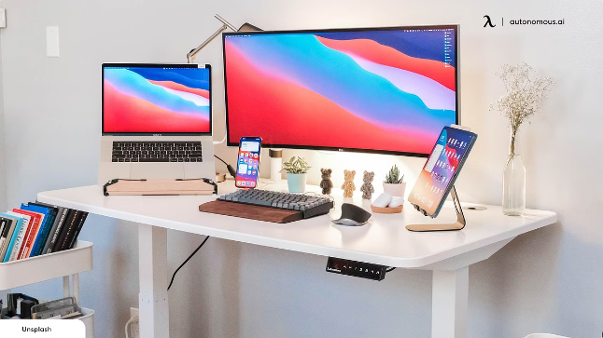
Introduction to Computers
The world of computing is vast and ever-evolving. Understanding its fundamentals empowers us to navigate this technological landscape and harness its potential.

Slide 2
Hardware Components
Computers are built from a collection of physical parts called hardware. These components work together to process data, store information, and communicate with users.
Central Processing Unit (CPU)
Random Access Memory (RAM)
Storage Devices
Long-term memory that stores data permanently, such as hard drives, solid state drives, and USB drives.
The brain of the computer, responsible for executing instructions and performing calculations.
Short-term memory that stores data actively being used by the computer.

Slide 3
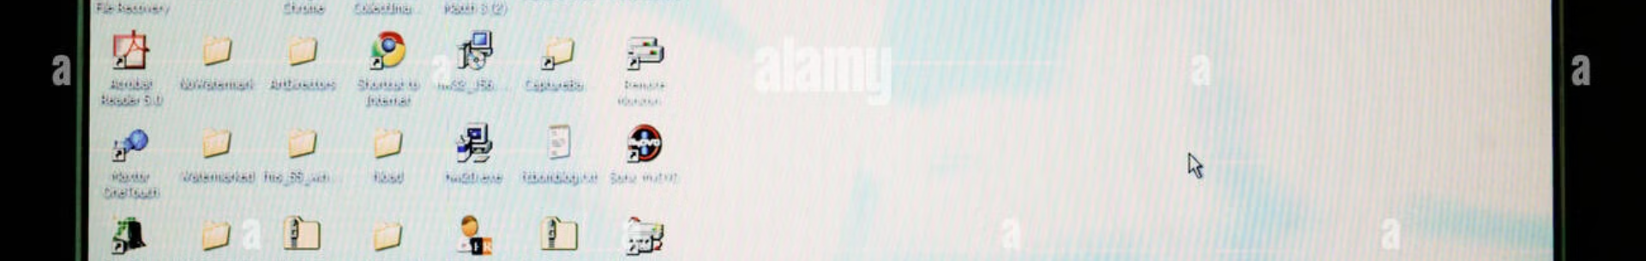
Software and Operating Systems
Software refers to the programs and instructions that tell hardware what to do. Operating systems act as the foundation, managing the computer's resources and providing an interface for users.
1
Operating System (OS)
2
Application Software
A software program that manages the computer's hardware and provides a platform for other software to run.
Programs designed for specific tasks, such as web browsing, word processing, and gaming.
3
System Software
4
Utility Software
Programs that manage the computer's resources and support the operation of application software.
Programs that perform tasks related to system maintenance, such as virus scanning, disk cleanup, and data backup.

Slide 4
Data Storage and Management
Data is the raw material computers process and store. Efficient data management ensures data integrity, accessibility, and security.
Data Collection
1
Gathering data from various sources, such as sensors, databases, and user input.
2
Data Storage
Storing data in a structured and organized manner, using databases, file systems, and cloud storage.
Data Retrieval
3
Accessing and retrieving stored data when needed for analysis, processing, or display.
4
Data Backup
Creating copies of data to protect against data loss due to hardware failure or other incidents.
Data Security
5
Implementing measures to protect data from unauthorized access, modification, or deletion.

Slide 5

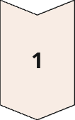
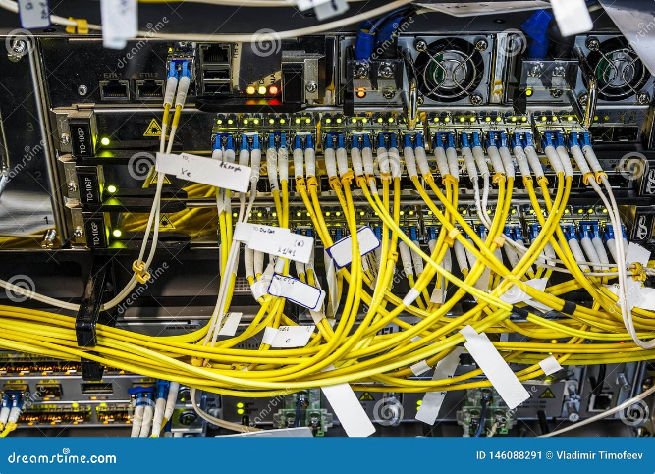
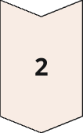
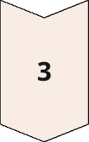
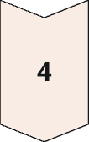
Internet and Networking
The internet is a global network connecting computers and devices worldwide. Networking enables communication and data sharing between these connected devices.
Internet Protocol (IP)
A set of rules that govern communication between devices on the internet.
Transmission Control Protocol (TCP)
A protocol that ensures reliable and ordered delivery of data over the internet.
Domain Name System (DNS)
A system that translates human-readable domain names into computer-readable IP addresses.
World Wide Web (WWW)
A collection of interconnected documents and resources accessible over the internet.

Slide 6

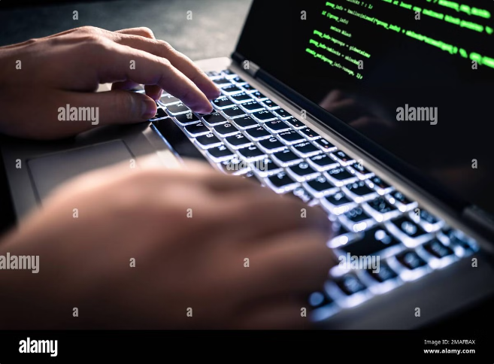
Cybersecurity and Privacy
Cybersecurity involves protecting computer systems and networks from unauthorized access, use, disclosure, disruption, modification, or destruction.
Password Management
Firewall
Using strong passwords and keeping them secure to prevent unauthorized access.
A software or hardware system that acts as a barrier between a computer network and the outside world.
Antivirus Software
Data Encryption
Software that protects computers from malware, such as viruses, worms, and Trojan horses.
Converting data into an unreadable format, making it inaccessible to unauthorized users.

Slide 7

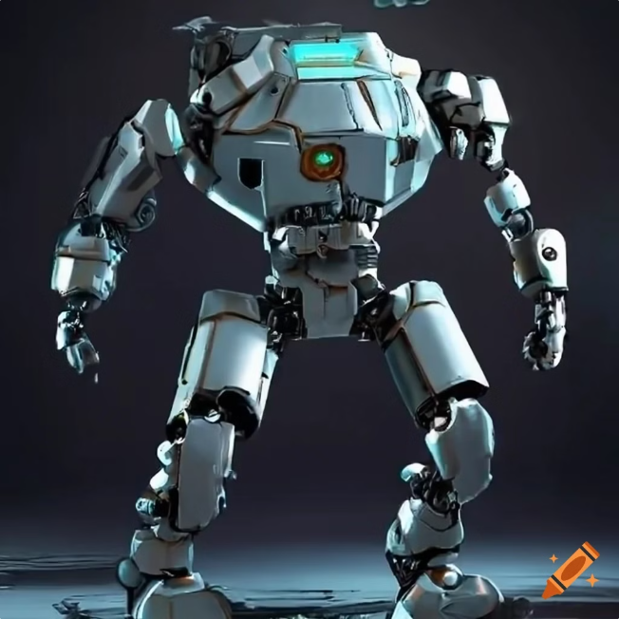




Emerging Technologies
The field of computer science is constantly evolving, with new technologies emerging at a rapid pace.
Artificial Intelligence (AI)
Virtual Reality (VR)
Developing machines that can perform tasks that typically require human intelligence.
Creating immersive experiences that simulate real-world environments or imaginary worlds.
Blockchain
Quantum Computing
A decentralized, secure, and transparent ledger that records transactions and data.
A new type of computing that utilizes quantum mechanics to solve complex problems.

Slide 8
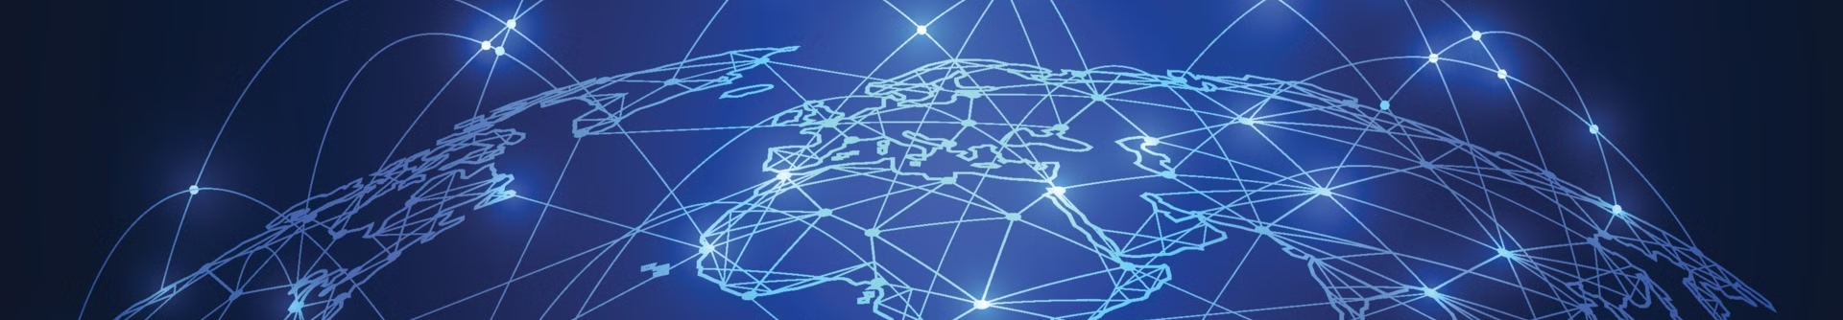
Conclusion and Key Takeaways
Computers have transformed our lives, empowering us to connect, create, and innovate. Understanding the fundamentals of computing allows us to harness its potential.
Key Takeaway 1
Computers are composed of hardware and software that work together.
Key Takeaway 2
The internet and networking connect computers globally, enabling communication and data sharing.
Key Takeaway 3
Emerging technologies like AI and quantum computing are pushing the boundaries of what computers can do.

Slide 9

Thank you for watching my presentation

